Slide 1
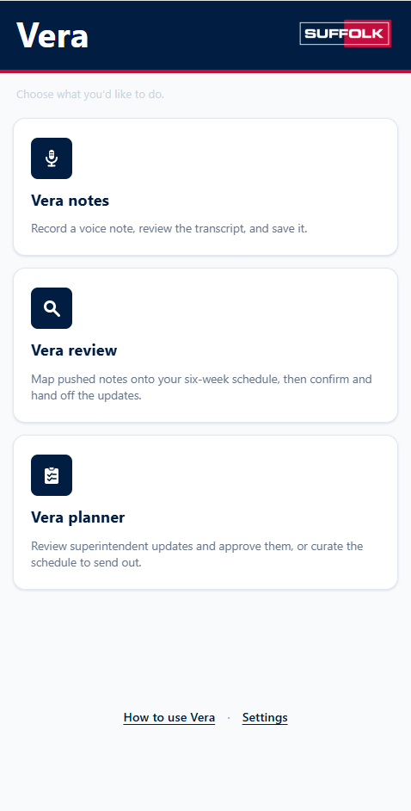
DATA SCIENCE LAB
VERA NOTES
Shiny Apps
Built For Construction
Lucas Da Silva
Data Analyst, Data Product Team · Suffolk Construction
MOBILE · VOICE · ACTION
Notes:
Timing: ~25 seconds
Hi everyone—I'm Lucas Da Silva, a data analyst on Suffolk Construction's Data Product Team. Today I'll show a pre-pilot app called Vera Notes: an example of using Shiny as a mobile, voice-enabled workflow rather than only as a dashboard or report.
[Sources]
- User-provided Vera application home-screen screenshot, supplied in this conversation.

Slide 2
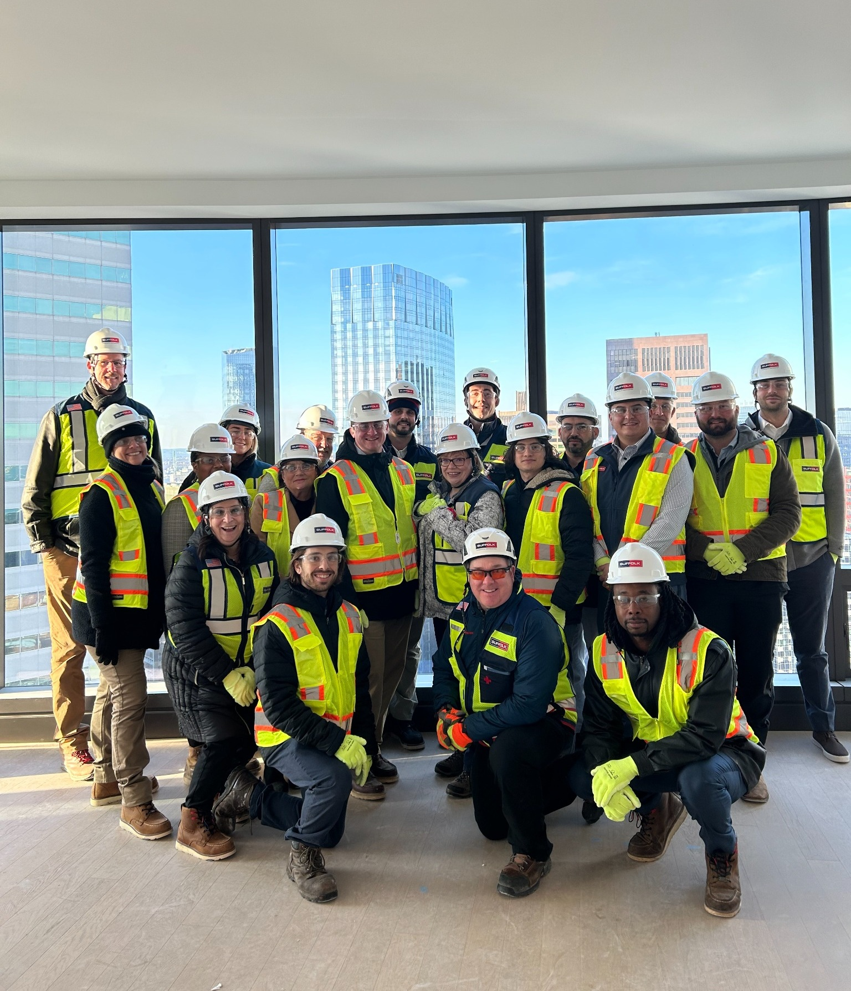

A quick introduction
LUCAS DA SILVA
Data Analyst
CONTEXT
Construction work happens away from the desk.
Data Product Team · Suffolk Construction
I work on data products that help construction teams capture, structure, and act on information from their day-to-day workflows.
TODAY: VERA NOTES
A voice-first daily-log workflow built as a mobile Shiny experience.
ON SITE WITH THE SUFFOLK TEAM
Notes:
Timing: ~35 seconds
I'm a data analyst on Suffolk's Data Product Team. The common thread in our work is turning real construction workflows into usable data products. For this talk, the workflow is daily logs—information created in the field that eventually needs to inform schedule updates. This photo shows me on site with Suffolk colleagues.
[Sources]
- User-provided construction-site group photo featuring Lucas Da Silva and Suffolk colleagues, supplied in this conversation.

Slide 3
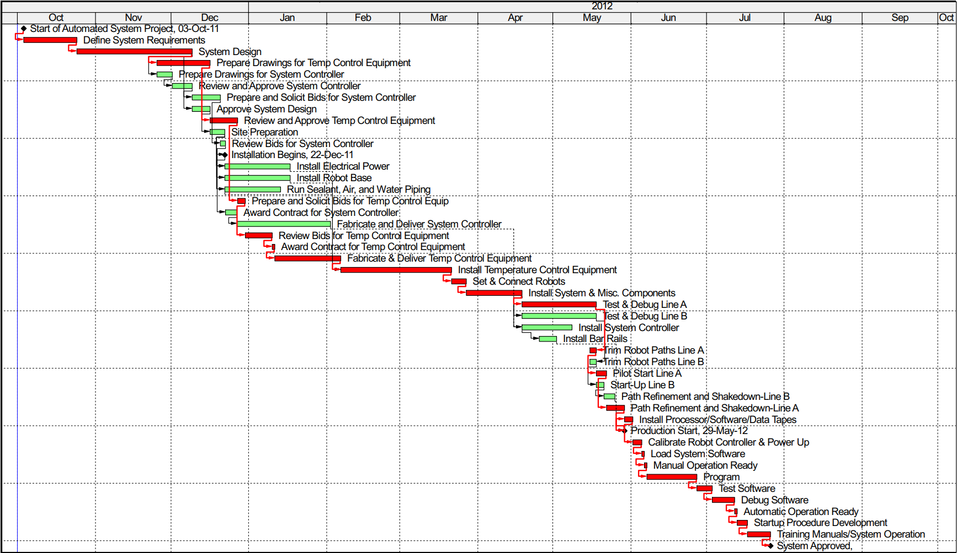
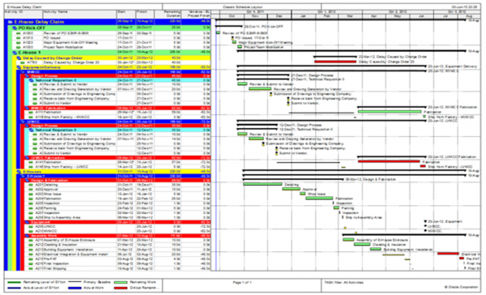
A (Very) Brief Overview of Construction Scheduling
What is a Construction Schedule?
  High-level overview of a construction job task by task
  Contractual document
  Owned by a Planner
How are Construction Schedules Maintained?
  Updates come in from Superintendents
  Planner owns the contractual document
  Superintendents manage daily execution of the job and provide updates
ON SITE WITH THE SUFFOLK TEAM
Notes:
Timing: ~35 seconds
I'm a data analyst on Suffolk's Data Product Team. The common thread in our work is turning real construction workflows into usable data products. For this talk, the workflow is daily logs—information created in the field that eventually needs to inform schedule updates. This photo shows me on site with Suffolk colleagues.
[Sources]
- User-provided construction-site group photo featuring Lucas Da Silva and Suffolk colleagues, supplied in this conversation.

Slide 4
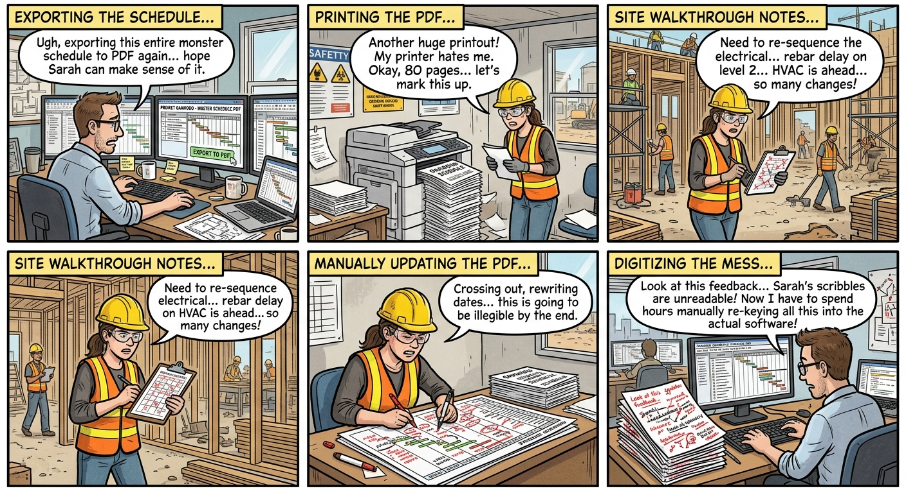
The Problem
The Worst Case of the Current Workflow Visualized as a Comic Book Strip
Capture the note once—while the context is fresh—and make it actionable from the beginning.
Notes:
Timing: ~50 seconds
Daily logs are a simple example of the broader paperwork challenge. The information is captured in the field, waits outside the systems that need it, and is re-entered later. Only then can it contribute to reporting or schedule updates. The opportunity is not to eliminate documentation—it is to capture it once and make it useful immediately.

Slide 5
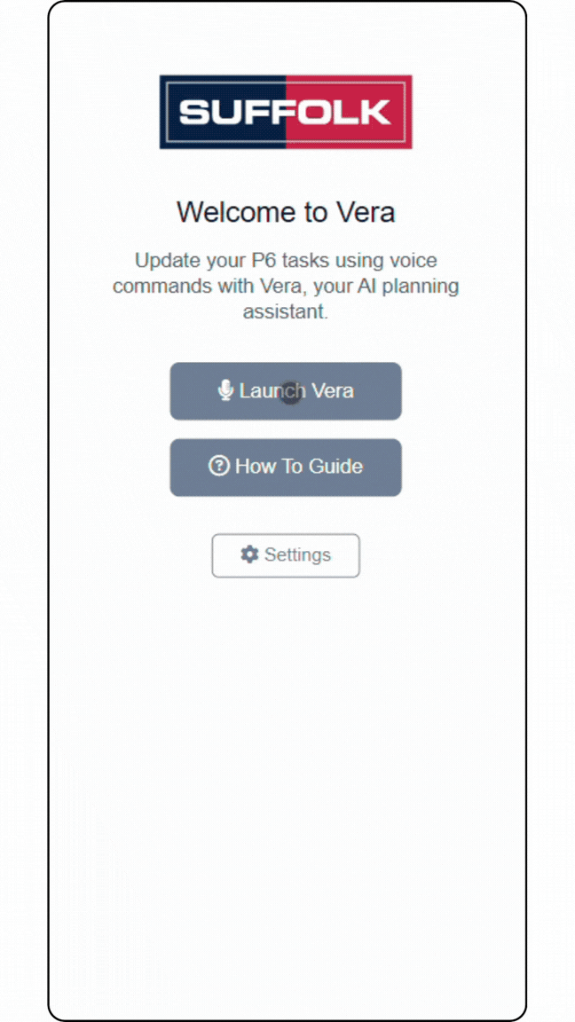
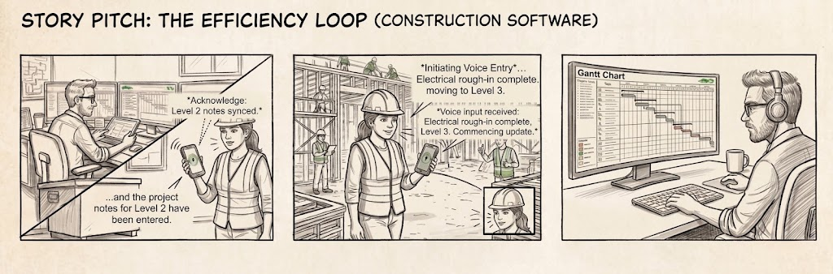
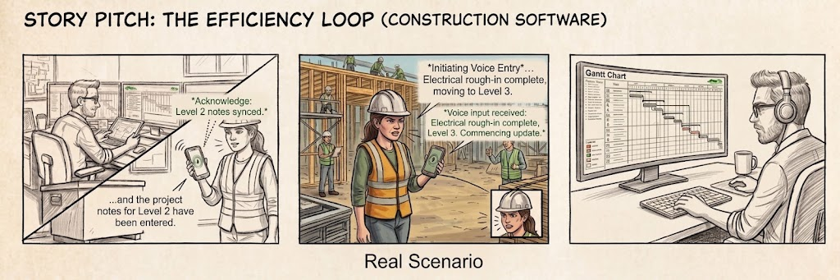
The Original Proposed Solution
And Why It Didn't Work...
Notes:
Timing: ~50 seconds
Daily logs are a simple example of the broader paperwork challenge. The information is captured in the field, waits outside the systems that need it, and is re-entered later. Only then can it contribute to reporting or schedule updates. The opportunity is not to eliminate documentation—it is to capture it once and make it useful immediately.

Slide 6
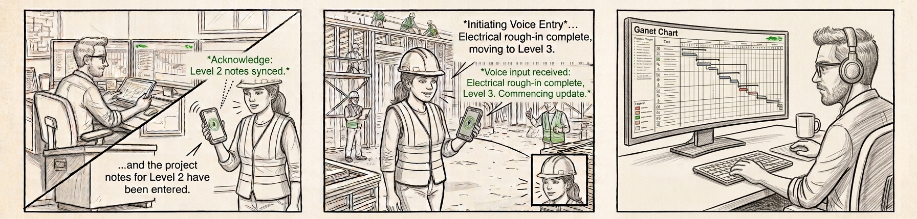
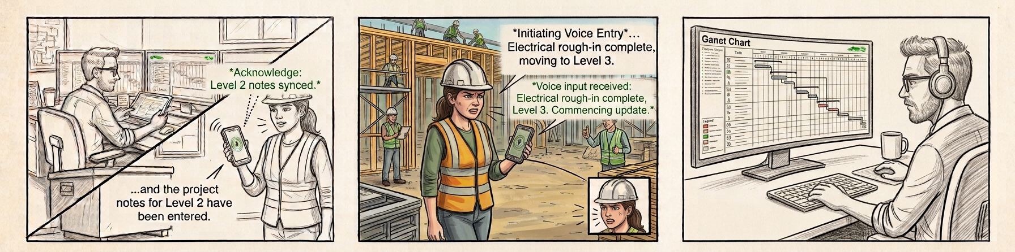
Two Product Design Lessons
Meet People Where They Are (We Did Ok Here)
2. Friction is Not Always An Obstacle (Not So Much Here)
Notes:
Timing: ~50 seconds
Daily logs are a simple example of the broader paperwork challenge. The information is captured in the field, waits outside the systems that need it, and is re-entered later. Only then can it contribute to reporting or schedule updates. The opportunity is not to eliminate documentation—it is to capture it once and make it useful immediately.

Slide 7
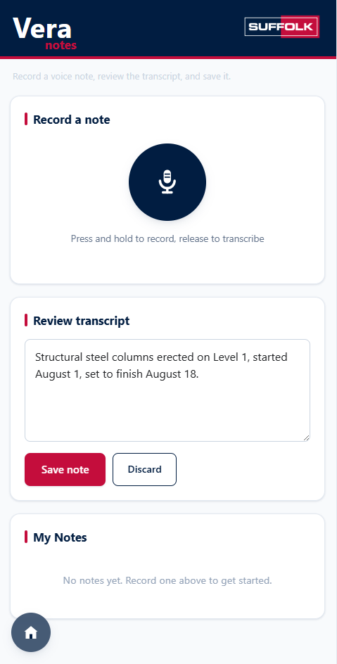
What Vera Notes changes
DEMO
1
Speak naturally in the field
Record the daily log by voice on a mobile device.
2
Review and edit the transcript
Keep the user in control before anything becomes system data.
3
Save and push the note
Move the cleaned note into the downstream workflow.
4
Auto-map to the schedule
Infer schedule updates from the note and connect them to the right activities.
Separate Modules Re-introduce Necessary Friction While Still Speeding Up The Workflow
Notes:
Timing before demo: ~45 seconds
Vera Notes moves digitization to the beginning of the workflow. A user speaks naturally, reviews and edits the transcript, saves and pushes the note, and the app can auto-map that note to the project schedule to infer updates. The important point for this audience is the interaction model: Shiny can meet a user on mobile and become the place where operational data begins. Let's see it in action.
[Sources]
- User-provided Vera Notes transcript-screen screenshot, supplied in this conversation.
https://www.loom.com/share/74e09b9b7eb64c76ab7dd80de6593298
https://www.loom.com/share/dd9a829194794bd6bf264a770218c88b

Slide 8
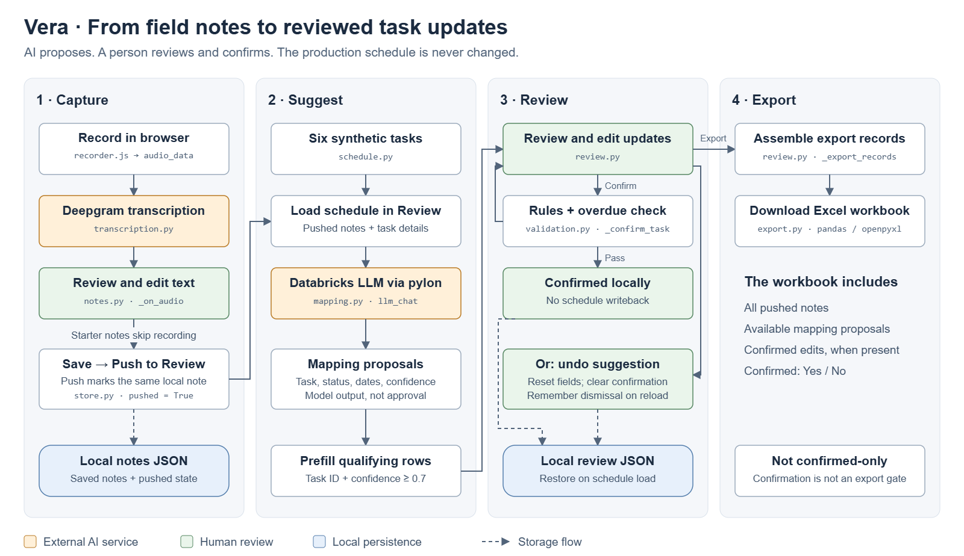
Workflow Diagram
DEMO
Notes:
Timing before demo: ~45 seconds
Vera Notes moves digitization to the beginning of the workflow. A user speaks naturally, reviews and edits the transcript, saves and pushes the note, and the app can auto-map that note to the project schedule to infer updates. The important point for this audience is the interaction model: Shiny can meet a user on mobile and become the place where operational data begins. Let's see it in action.
[Sources]
- User-provided Vera Notes transcript-screen screenshot, supplied in this conversation.
https://www.loom.com/share/74e09b9b7eb64c76ab7dd80de6593298
https://www.loom.com/share/dd9a829194794bd6bf264a770218c88b

Slide 9

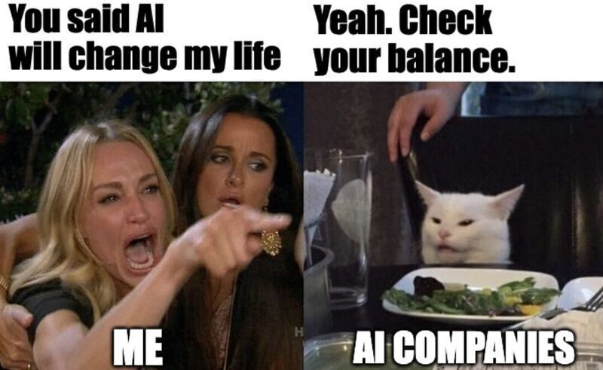
The Story of AQuA (Bonus Time)
Talk to Your Data
  Semi-technical stakeholders want more hands-on connection to their data
  Large amount of adhoc data pull requests slowing down Data Team
Build vs Buy
  Services on the market
    Expensive, slow, or inaccurate
  Attempt to build using best practices
    Adhoc Query Agent (AQuA!)
ON SITE WITH THE SUFFOLK TEAM
Notes:
Timing: ~35 seconds
I'm a data analyst on Suffolk's Data Product Team. The common thread in our work is turning real construction workflows into usable data products. For this talk, the workflow is daily logs—information created in the field that eventually needs to inform schedule updates. This photo shows me on site with Suffolk colleagues.
[Sources]
- User-provided construction-site group photo featuring Lucas Da Silva and Suffolk colleagues, supplied in this conversation.

Slide 10
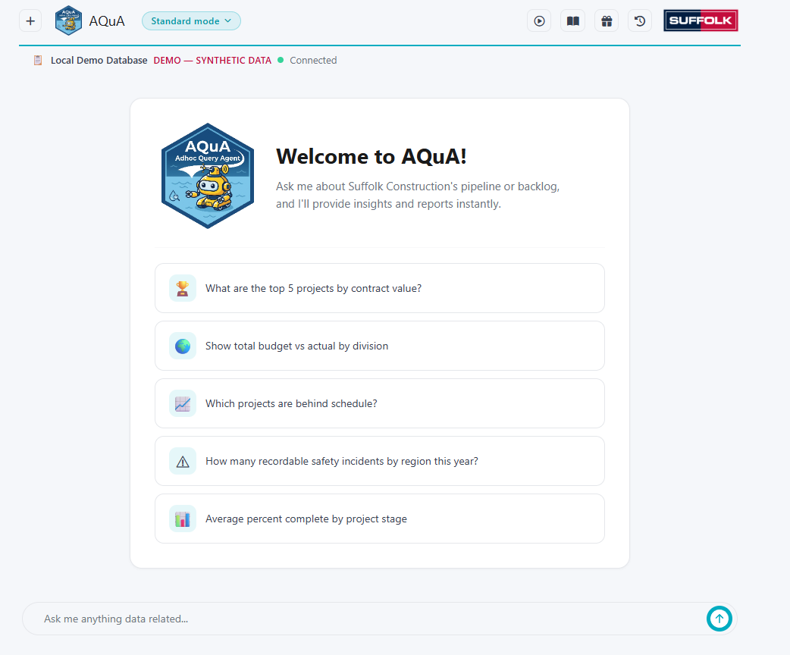
AQuA (Bonus Time)
DEMO
1
Context Gathering Every Time No Exceptions
Pull User Pushed Context, List Tables, Describe Tables
2
Online Feedback Loop
Users can push business context/rules into a Knowledge Base that loops back to the agent in later sessions
3
User Permissions + Read Only Security
OAuth allows for user permissioning via the datalake so nobody can see what they are not supposed to + additional sqlglot style guardrails
4
Error Resistance
Errors from the datalake come back to the agent with suggestions on how to resolve them
Notes:
Timing before demo: ~45 seconds
Vera Notes moves digitization to the beginning of the workflow. A user speaks naturally, reviews and edits the transcript, saves and pushes the note, and the app can auto-map that note to the project schedule to infer updates. The important point for this audience is the interaction model: Shiny can meet a user on mobile and become the place where operational data begins. Let's see it in action.
[Sources]
- User-provided Vera Notes transcript-screen screenshot, supplied in this conversation.
https://www.loom.com/share/74e09b9b7eb64c76ab7dd80de6593298
https://www.loom.com/share/dd9a829194794bd6bf264a770218c88b

Slide 11
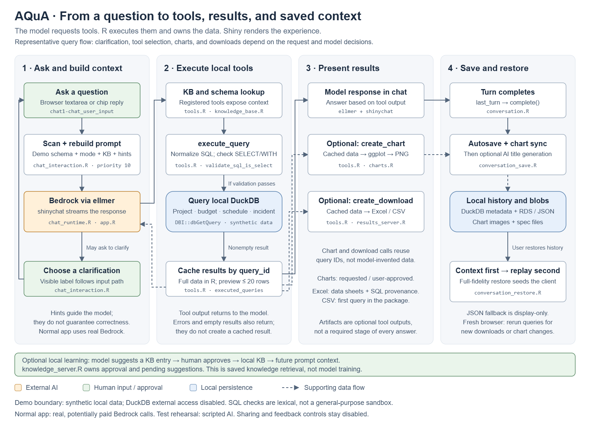
Workflow Diagram
DEMO
Notes:
Timing before demo: ~45 seconds
Vera Notes moves digitization to the beginning of the workflow. A user speaks naturally, reviews and edits the transcript, saves and pushes the note, and the app can auto-map that note to the project schedule to infer updates. The important point for this audience is the interaction model: Shiny can meet a user on mobile and become the place where operational data begins. Let's see it in action.
[Sources]
- User-provided Vera Notes transcript-screen screenshot, supplied in this conversation.
https://www.loom.com/share/74e09b9b7eb64c76ab7dd80de6593298
https://www.loom.com/share/dd9a829194794bd6bf264a770218c88b

Slide 12
Resources to Build Your Own
Voice-Enabled Applications
  Shinyrealtime
    https://github.com/posit-dev/shinyrealtime
  Deepgram
    https://deepgram.com
    https://github.com/deepgram/deepgram-python-sdk
Talk To Your Data Applications
  commons
    https://opensource.posit.co/blog/2026-09-15_commons-0-1-0/
    https://posit-dev.github.io/commons/
Other Cool Things I Saw At Conf That May (or May Not) Be Relevant
  shinyreact
    https://github.com/posit-dev/shinyreact
  data-dict
    https://data-dict.tidyverse.org/
4
Notes:
Timing before demo: ~45 seconds
Vera Notes moves digitization to the beginning of the workflow. A user speaks naturally, reviews and edits the transcript, saves and pushes the note, and the app can auto-map that note to the project schedule to infer updates. The important point for this audience is the interaction model: Shiny can meet a user on mobile and become the place where operational data begins. Let's see it in action.
[Sources]
- User-provided Vera Notes transcript-screen screenshot, supplied in this conversation.
https://www.loom.com/share/74e09b9b7eb64c76ab7dd80de6593298
https://www.loom.com/share/dd9a829194794bd6bf264a770218c88b

Slide 13
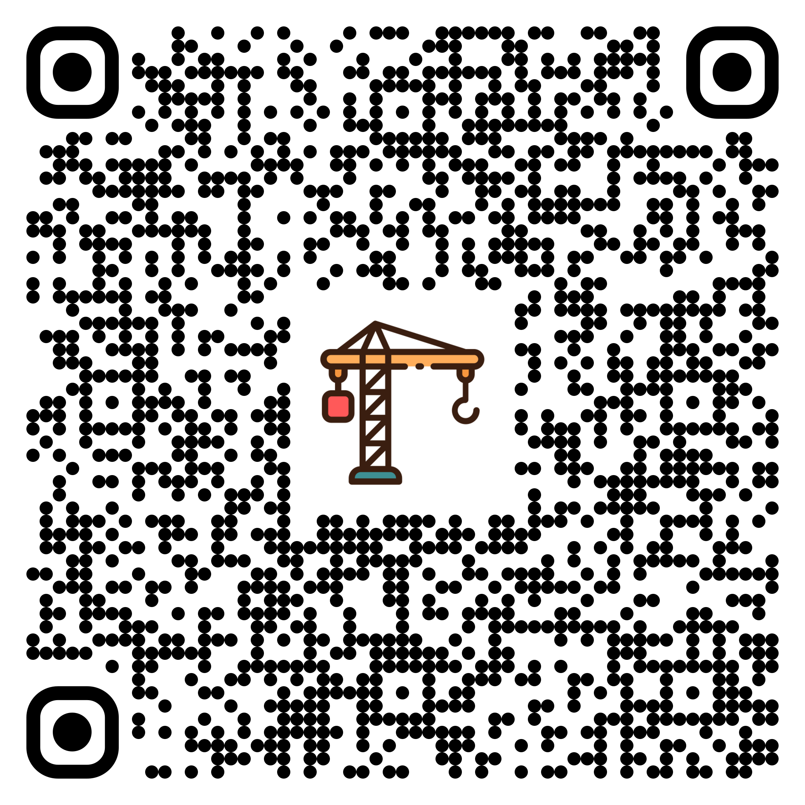
VERA NOTES
Connect With Me
Thank you
Lucas Da Silva · Data Analyst, Data Product Team · Suffolk Construction
QUESTIONS?
5
Notes:
Timing: ~15 seconds
The takeaway I hope you leave with is that Shiny can be more than the place where data is viewed. It can be the interaction layer where data begins—especially when we design for how users already work and communicate. Thank you.
[Sources]
- User-provided Vera Notes recording-state screenshot, supplied in this conversation.

